Slide 1
Analysis of customer churn data
Pranav Vinod
MTH 522 – Advanced Mathematical Statistics
University of Massachusetts, Dartmouth

Slide 2
Introduction
In this project, we will try to predict whether a customer will churn, i.e., if a customer will cancel their telecom subscription based on their activity data.
To do so, we will implement Logistic Regression, Random Forest and a Neural Network model to find the best one.
Data Source - Link
Notes:
Churn (loss of customers to competition) is a problem for telecom companies because it is more expensive to acquire a new customer than to keep your existing one from leaving
he company tries to identify in advance customers who are likely to churn. The company then targets those customers with special programs or incentives. This approach can bring in huge loss for a company, if churn predictions are inaccurate, because then firms are wasting incentive money on customers who would have stayed anyway.

Slide 3
Data description
COLUMN NAME | DESCRIPTION
State | State where the account is based
Account.length | Time that the account has been active
Area.code | Area code of the account
Internation.plan | Whether account has international plan or not
Voice.mail.plan | Whether account has voice plan or not
Number.vmail.messages | Number of voice mail messages
Total.day.minutes | Total day minutes used
Total.day.calls | Day calls made
Total.day.charge | Total day charge
Total.eve.minutes | Total evening minutes used
Total.eve.calls | Evening calls made
Total.eve.charge | Total evening charge
Total.night.minutes | Total night minutes used
Total.night.calls | Night calls made
Total.night.charge | Total night charge
Total.intl.minutes | Total international minutes used
Total.intl.calls | Total international calls made
Total.intl.charge | Total international charge
Customer.service.calls | Number of service calls made
Churn | Whether the customer churns, 0 if True, 1 if False
20 attributes : 4 categorical and 16 are numerical
The target variable is Churn. It has 2 factor levels: True and False
The state attribute is dropped from the dataset.
Notes:
Now is a short description of the dataset. The dataset consists of 2666 observations of 20 variables.
Of those 20, 4 including the target variable are categorical and 16 are numerical.
The target variable in this dataset is Churn, which is has 2 levels True and False signifying if a customer will leave the telecom network or not respectively.
From the outset, I have dropped the column with state names. It tells us the state where the account is based and I felt that information was being reflected in the Area code of the account column with the name Area Code. So it did not make sense to have 2 attributes conveying the same information.

Slide 4
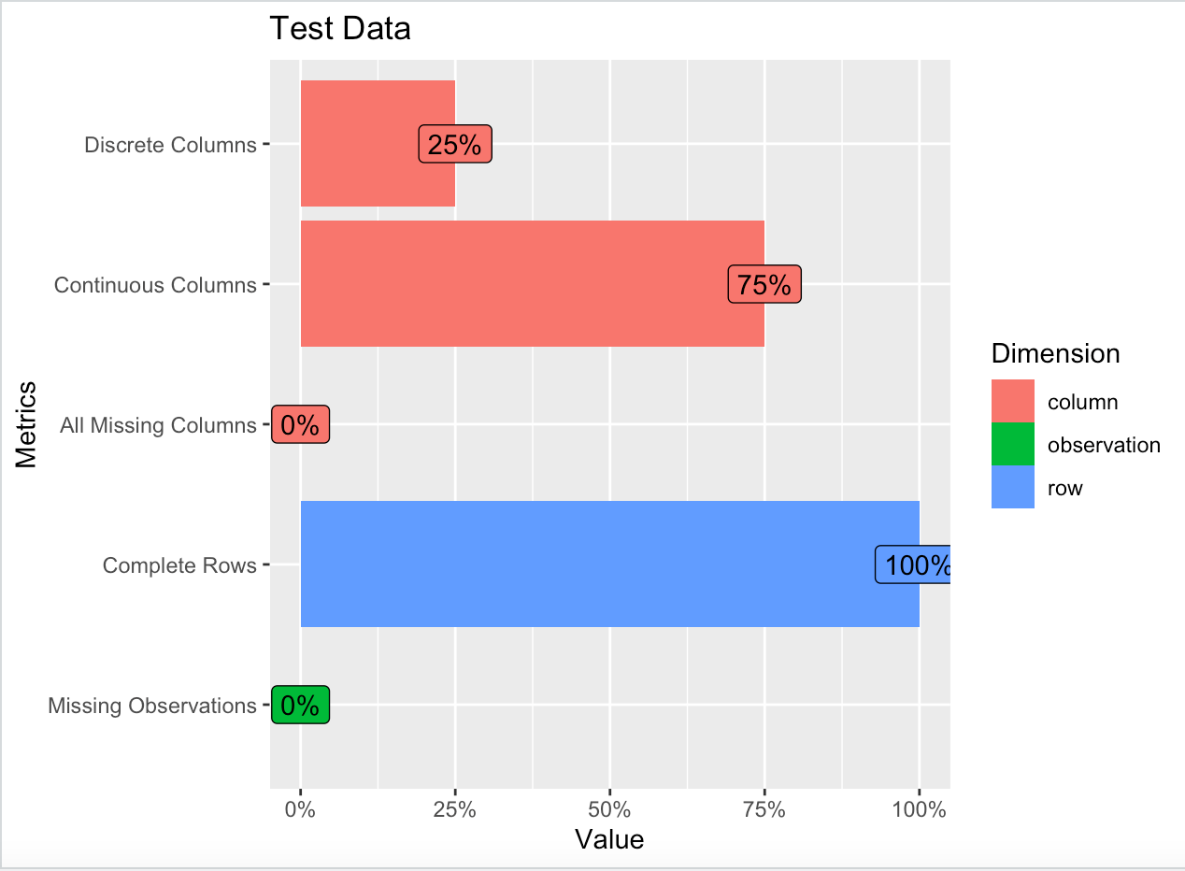
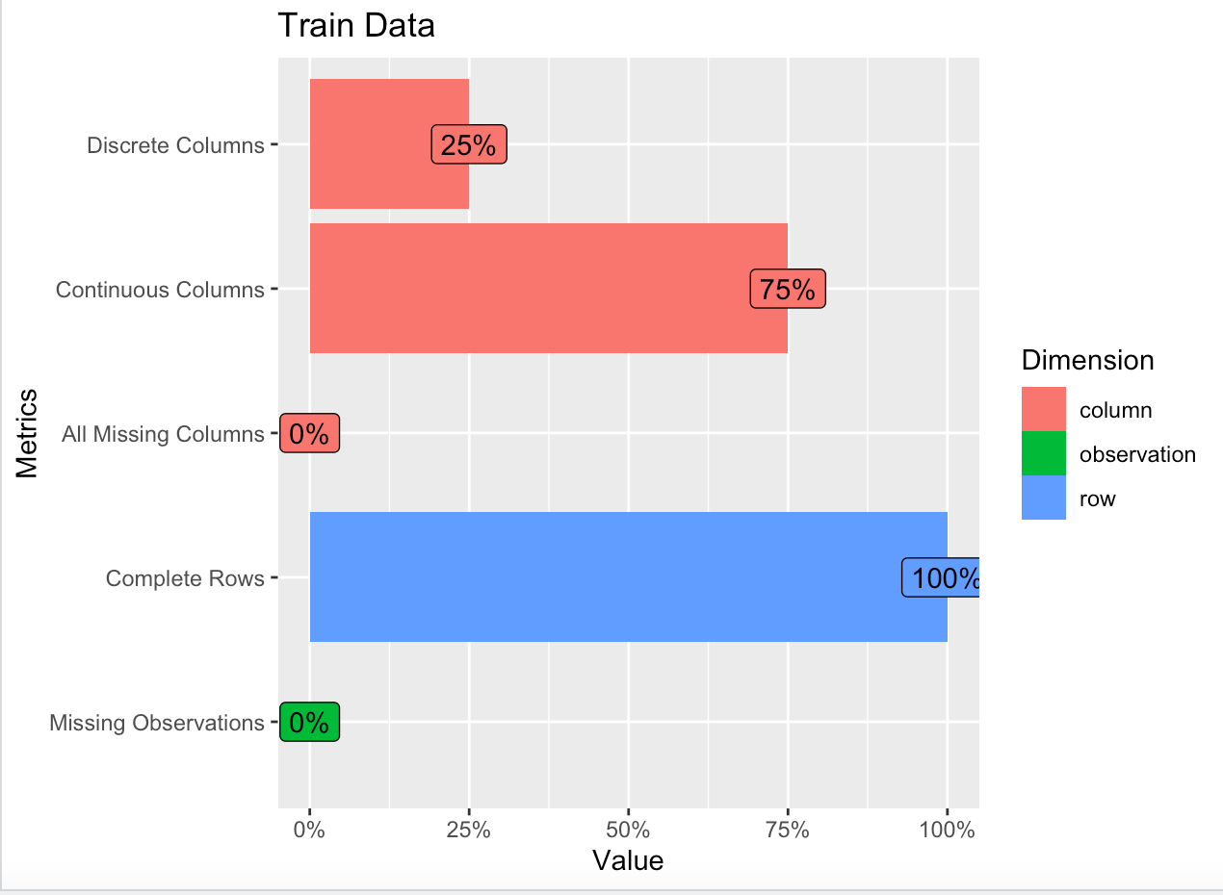
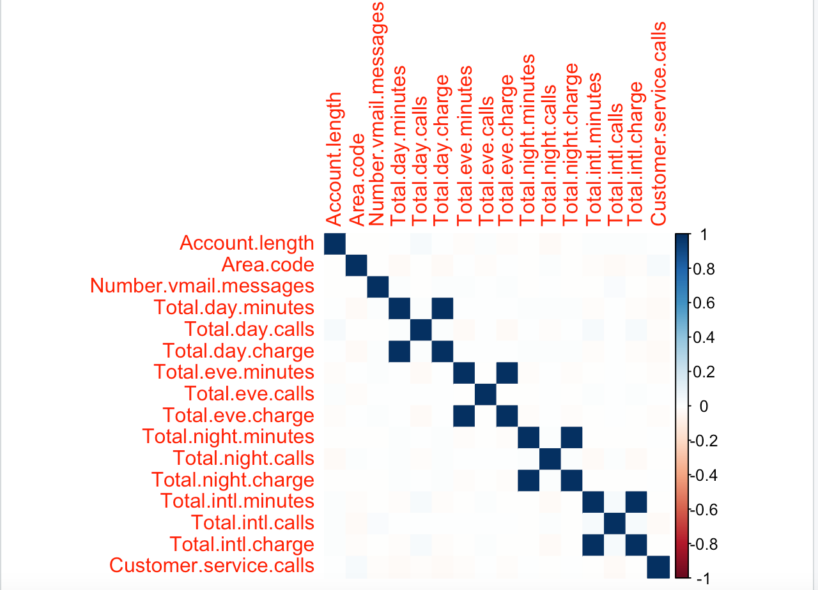
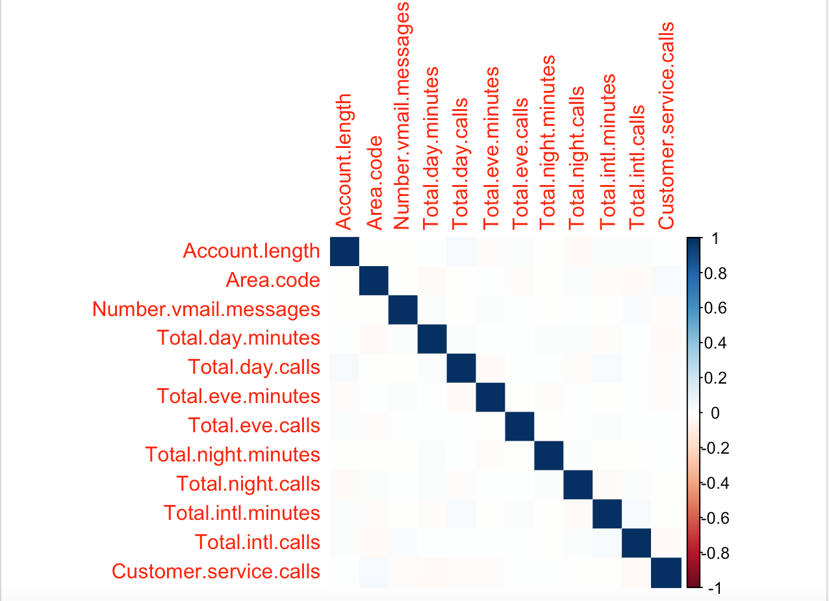
Data exploration
Notes:
Moving on, I explored the data and tried to find salient pattern using exploratory data analysis. I found that:
The plots on the top tell us about the structure of the train and test data. Both of them contain no missing values which is a relief and as mentioned have 16 numerical columns and 4 categorical columns.
Further, I tried to find the correlation between the numerical variables present in the dataset. Upon inspection, These were Total day charge/Total day minutes. Total night charge/total night minutes. Total evening charge/total evening minutes. Total international charge/total intl minutes. It is sensible that these pairs of attributes are correlated among themselves because money charged to a person would be proportional to the total minutes that they have use the network for. It did not make sense to keep these correlated variables in the dataset. So I dropped the columns for all the charges and kept information about the total minutes in the training set. I found that 4 pairs of attributes were strongly positively correlated to each other.

Slide 5
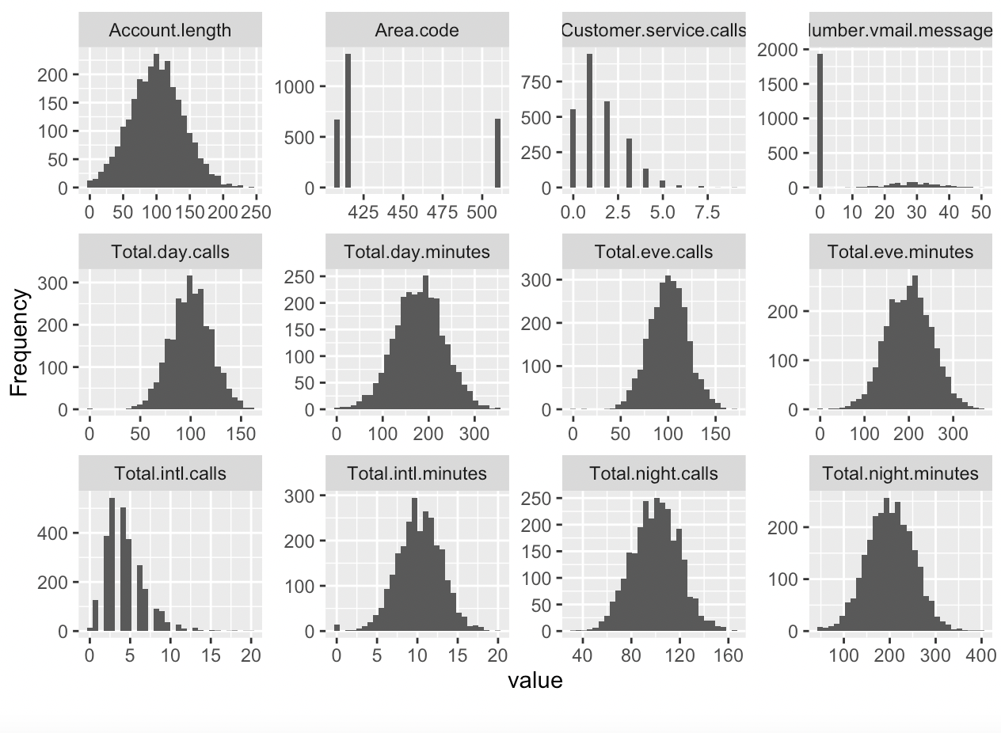
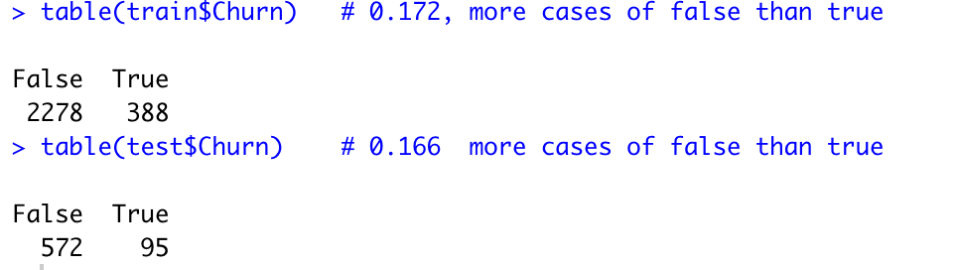
Data Exploration Cont.
Notes:
Moving on, I plotted the frequency distribution for all numerical variables in the dataset. And I found that most of the attributes followed a normal distribution.
Lastly, I tried to find that distribution of the target variable churn.
Found that the majority of the cases were for people who did not churn. There were 2278 cases for people who did not churn whereas there were only 388 observations for people who left the network for their competition. The ratio was consistent throughout the train and the test set at approx. 0.170 for true to false observations.

Slide 6
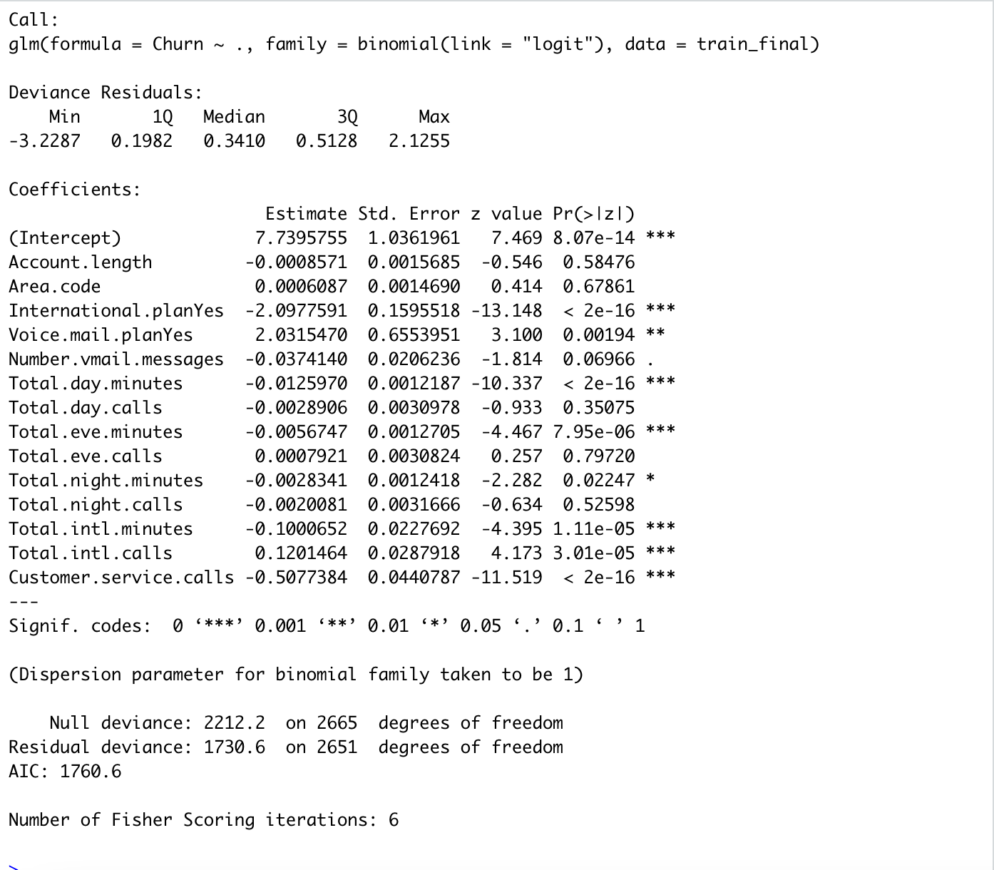
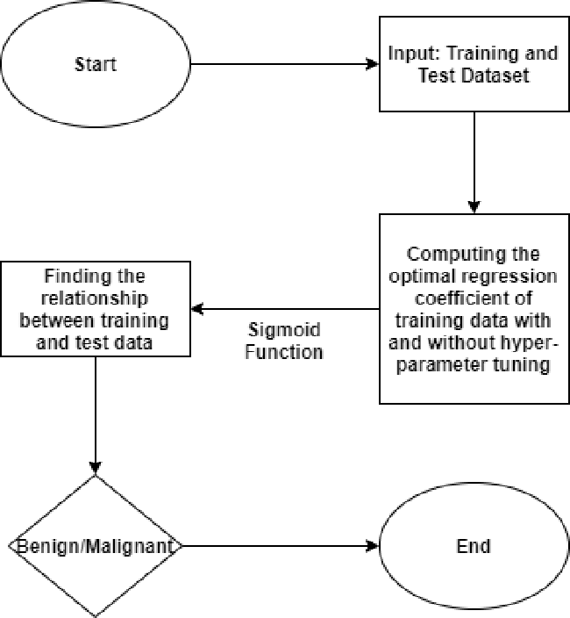
Logistic Regression
Notes:
Now having explored and processed the data, I implemented the first of my 3 classification models: The logistic regression
I will briefly take you through the algorithm:
1.We start off with the training and testing set
2. We compute the optimal regression coefficients with the training data
3. Then using the sigmoid/logit function, we find the relationship between the probabilities and the regression output
4. Finally, we interpret those output in the context of out dataset and evaluate our model.
For my implementation, I found the result summary as shown on the screenshot on the right. We can see that not all variables are significant.
Further, we desire a small residual deviance as compared to the null deviance. But we can see that the difference between residual and null deviance is not that high.
Further, the model has a relatively high AIC value of 1760.6

Slide 7
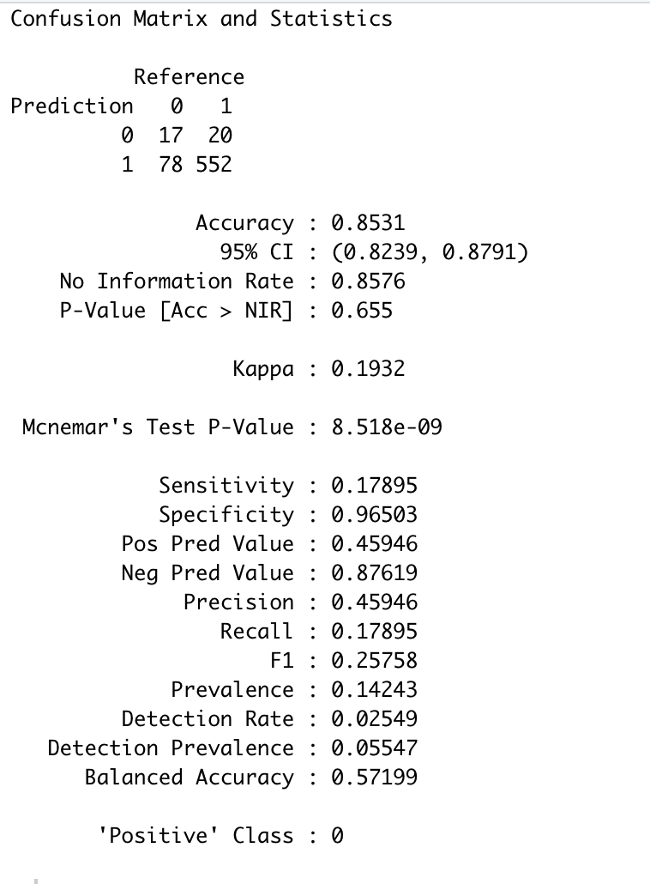
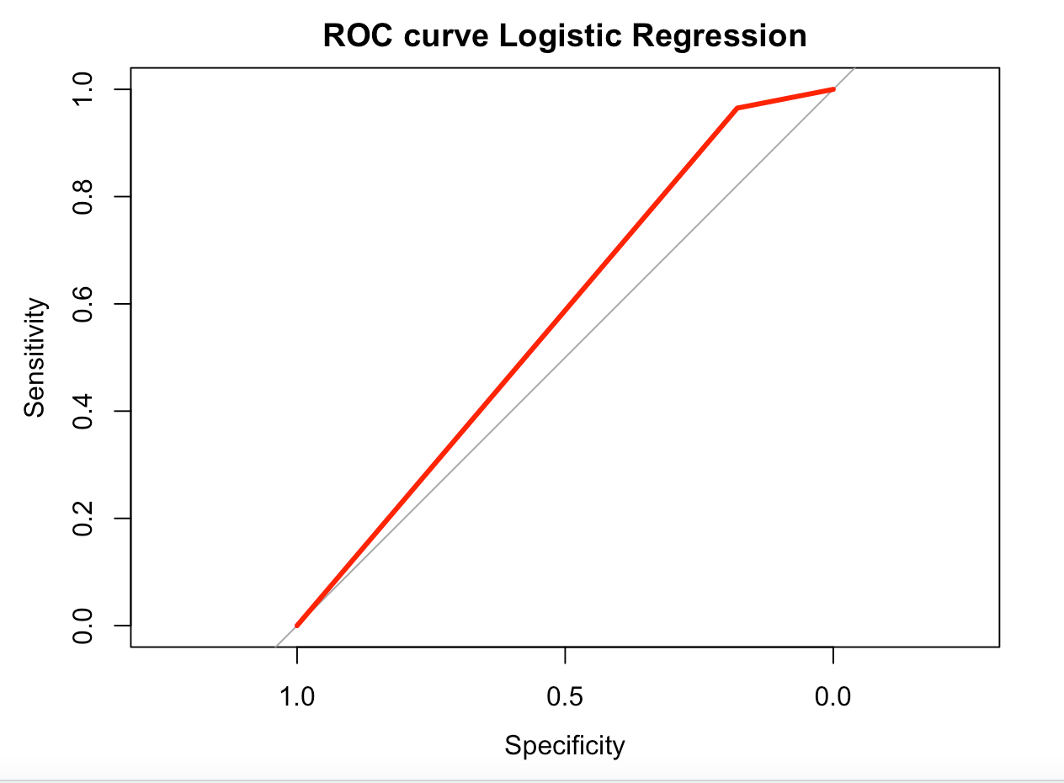
Results from Logistic regression
Notes:
To further evaluate the model on the testing set, I evaluated the confusion table and then the ROC curve for logistic regression model.
The model had an accuracy of 85% which is good but it had a ROC curve which does not have the ideal shape. Further, its AUC is low at 0.572. It also has a low F1 score of 25.7%.
Due to the low AUC and problems with the deviance values, I implemented a random forest on the same dataset.

Slide 8
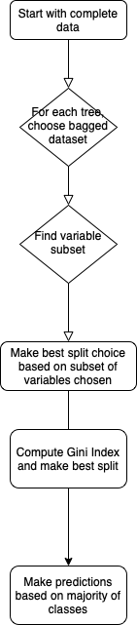
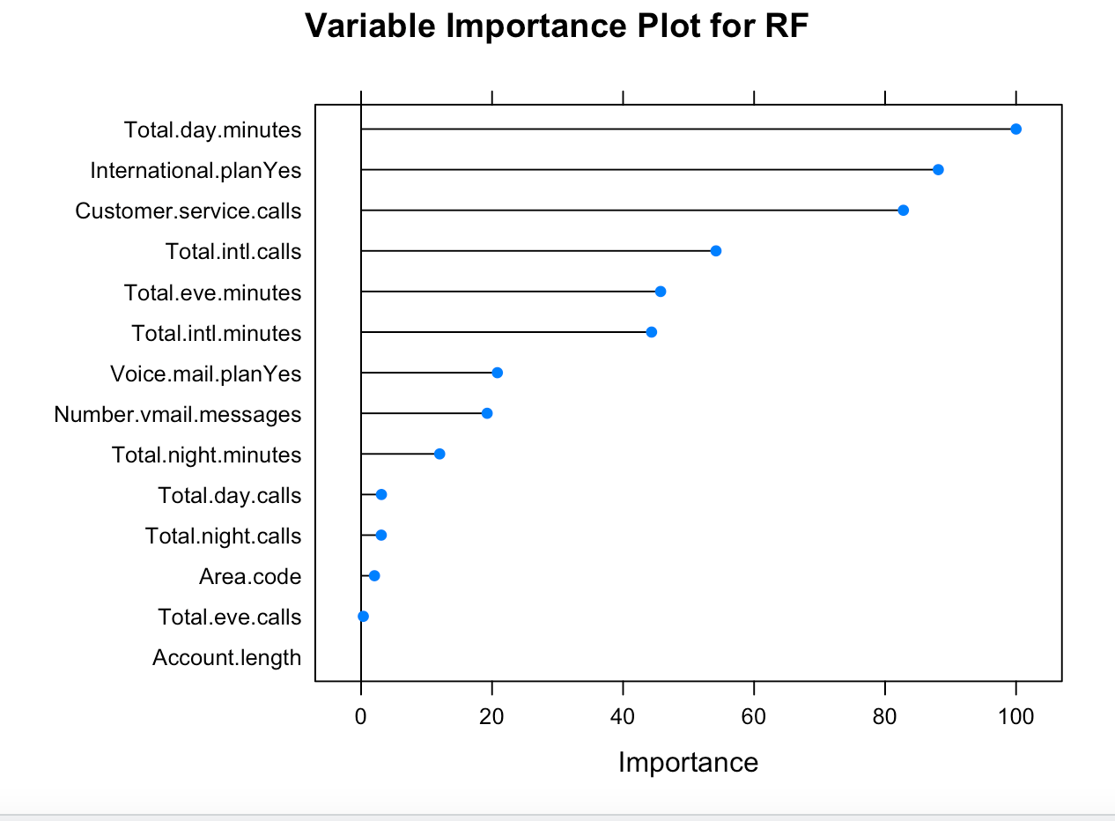
Random Forest
Notes:
I will briefly explain the algorithm for a random forest model before interpreting the results:
The steps are:
We start with the complete dataset
Then instead of using the train set to start building our tree, we will use a boosted dataset, which is obtained by randomly selecting observations from the train set with replacement. For each tree in our forest, we will chose a unique boosted dataset and start building our tree.
Now at each split, we have a choice of variables to choose from. We will randomly select a subset of variables to choose from and constrain ourselves to that subset at each split.
To find the best split, we will compute the Gini index for each possible split and choose the one with the smallest Gini index.
Finally, on our forest, we will make predictions based on the output from the majority of the trees for a classification problem.
On the left is a variable importance plot, in decreasing order of importance in making predictions on churn of customer. The most important variable is the total call minutes in a day and the least is the length of the account of the customer with the company.

Slide 9
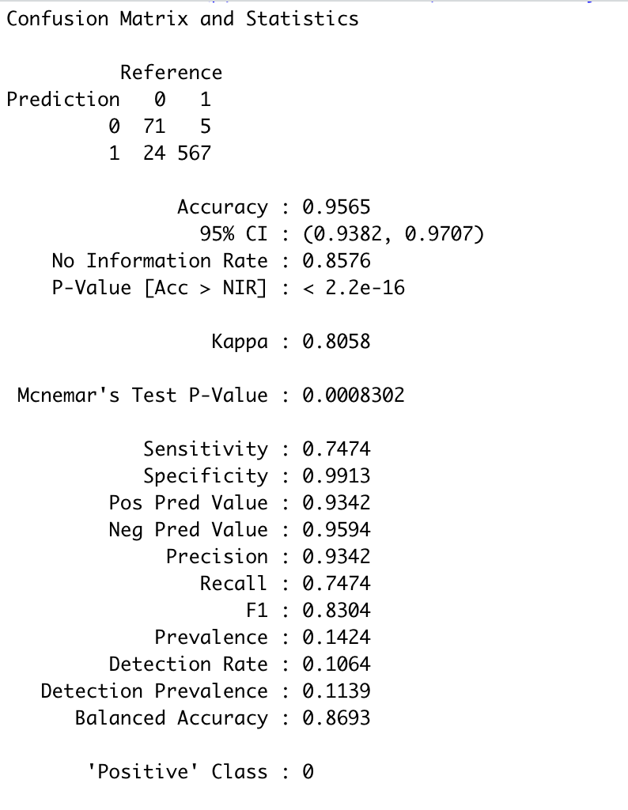
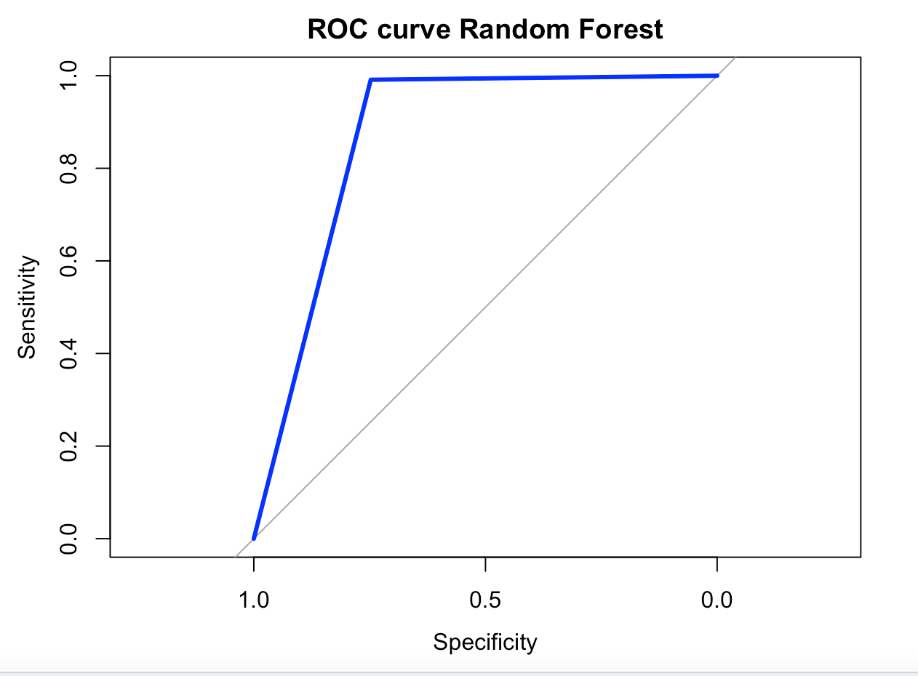
Results from Random Forest
Notes:
Having performed a random forest, we can see that it performs significantly better than logistic regression for this dataset.
It has a high accuracy at 95.6% and an Area under curve of 0.868.It also has an F1 score of 83.04. On both the comparison metrics, random forest performs better.
Having achieved a high accuracy, I tried to better it by implementing a neural network on this dataset.

Slide 10
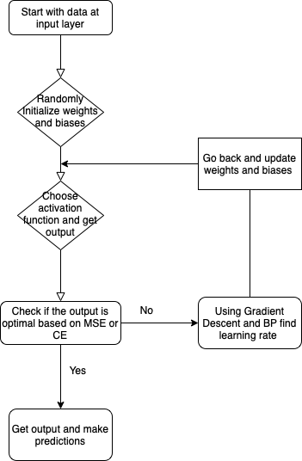
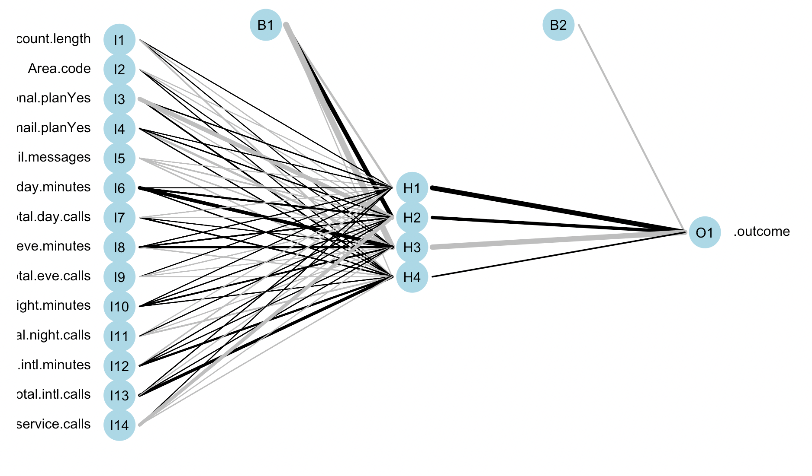
Neural Network
Notes:
The flowchart on the screen tells us the neural network algorithm.
It involved randomly initializing weights and biases in the network and then getting an output based on those parameters and the chosen activation function.
Having the output as a function of all the parameters in the network, we implement gradient descent to find the optimal value of correction and find the learning rate for those parameters. Finally, using backpropagation, we go back and update these weights and biases until we get an output that does not change beyond a point. The function to minimize in this case is the Cross Entropy in the network for classification problems.
The achieved network is as follows with 1 hidden layer and 4 nodes.

Slide 11
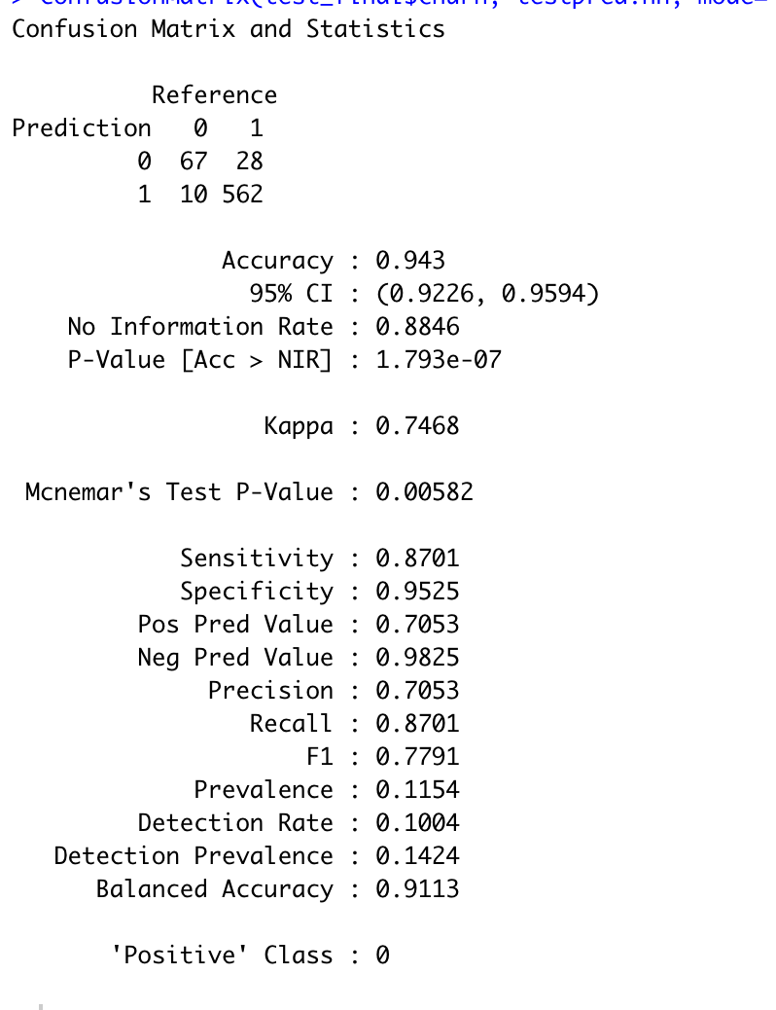
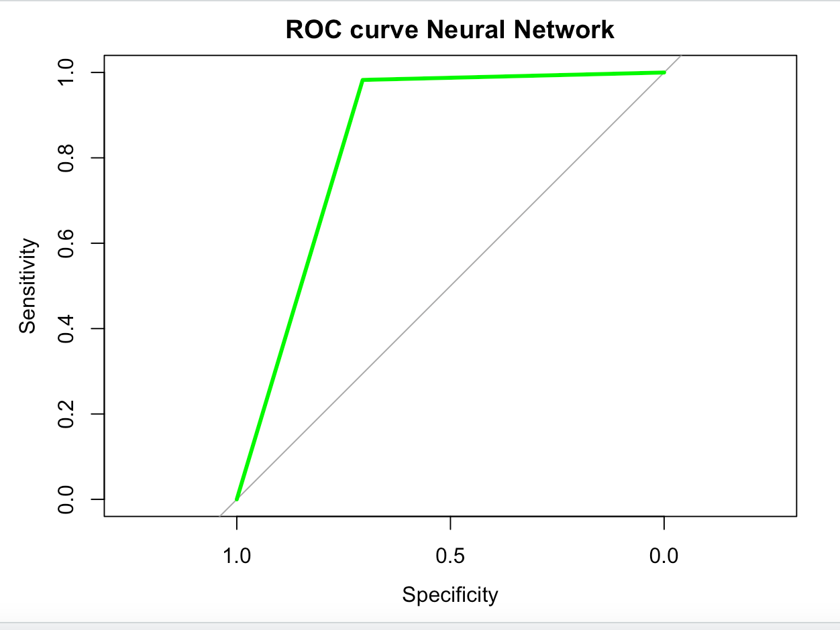
Results from Neural Network
Notes:
The results from the neural network were as follows:
It had a high accuracy of 94.3% and an AUC of 0.844.It also has an F1 score of 77.9% Based on these results, we can finally compare all the three models.

Slide 12
Comparison b/w models
 | Logistic Regression | Random Forest | Neural Network
Accuracy | 0.853 | 0.956 | 0.943
AUC | 0.572 | 0.868 | 0.844
F1 Score | 0.257 | 0.830 | 0.779
Notes:
On comparing the three models based on Accuracy and AUC of the model, we can see that logistic regression performs the worst among the three.
Among the other two, random forest performs marginally better than neural network but the difference is very small. Both have high accuracy approximately equal to 95% and an area under the ROC curve of 0.86 and 0.84 respectively.
Further when we look at the F1 score, random forest performs better than neural network significantly.
Further, since I got this dataset from Kaggle.com and it was openly available. Some people have previously worked on it and achieved an accuracy of 93% using random forest model.
Therefore, I would recommend using the random forest to predict whether customers will churn or not based on their activity data. The company can target those customers with specialized programs to keep them.

Slide 13
References
https://www.researchgate.net/figure/Algorithmic-flow-chart-of-Logistic-Regression-Lei-et-al-2016-42-Support-vector_fig3_343472002
https://www.crowdanalytix.com/contests/why-customer-churn
Dataset
https://medium.com/analytics-vidhya/accuracy-vs-f1-score-6258237beca2
Thank you!

